Slide 1
M&G Annual Investment Forum
2024 Key Information

Slide 2
Annual Investment Forum 2024
Objective | KPI
To elevate brand awareness and preference with key clients globally | UK: Improvement in brand rankings International: Event feedback metric to gauge preference with key clients
To demonstrate M&G Investment’s thought leadership, showcase innovative ideas, breadth of capabilities and be front of mind for investors | Content feedback to be on average, above 4/5 No show rate of less than 15% (avg is 30+%)
To create opportunity for clients to network, ask questions and engage with both M&G decision makers and industry experts | Requests for follow up meetings Retention rate for networking elements
Launch the new creative platform, make a strong statement to the market that “M&G is back” | Event feedback metric to gauge preference with key clients Increased engagement on social media

Slide 3
Date and Format
 | Date | Timings | Client groups
UK | Tues 30th January |  | UK Investment professionals, predominately existing clients; aiming for 80% of the delegates to be gatekeepers Usually between 100 -130 clients in attendance
Global | Weds 31st January |  | Investment professionals from across the globe (Europe, LATAM & Asia); Asset allocators, Heads of fund selectors, product and investment heads - large advisors and senior bankers. Usually between 100 - 130 clients in attendance, around 10 - 15 from each region
Internal – GSM | Thursday 1st Feb |  | GSM + Sales dinner

Slide 4
Timings
Draft agenda: timings subject to change
UK Annual Investment Forum 2024
Tuesday 30th January
Start Time | End Time | Agenda | Location: The Londoner
12:00 | 13:00 | Registration & Lunch | Ballroom Foyer
13:00 | 13:05 | Welcome: Alex Matcham | Ballroom
13:05 | 13:10 | Introduction: Joseph Pinto | Ballroom
13:10 | 13:40 | Main Platform | Ballroom
13:40 | 14:10 | Main Platform | Ballroom
14:10 | 14:30 | Changeover
14:30 | 15:15 | Boardroom session 1 | The Gallery / Ballroom
15:15 | 15:40 | Break
15:40 | 16:25 | Boardroom session 2 | The Gallery / Ballroom
16:25 | 16:35 | Changeover
16:35 | 17:20 | Boardroom session 3 | The Gallery / Ballroom
17:20 | 18:30 | Informal Discussions & Networking Drinks | The Green Room
18:30 |  | Event Close
Global Annual Investment Forum 2024
Wednesday 31st January
Start Time | End Time | Agenda | Location: The Londoner
11:00 | 11:30 | Registration, Luggage Drop & Light Brunch | Ballroom Foyer
11:30 | 11:35 | Welcome & Introduction: Joseph Pinto | Ballroom
11:35 | 12:15 | Main Platform | Ballroom
12:15 | 13:00 | Main Platform | Ballroom
13:00 | 13:15 | Changeover | Ballroom
13:15 | 14:00 | Boardroom session 1 | The Gallery / Ballroom
14:00 | 14:45 | Lunch
14:45 | 15:30 | Boardroom session 2 | The Gallery / Ballroom
15:30 | 15:40 | Changeover
15:40 | 16:25 | Boardroom session 3
16:25 | 16:45 | Coffee Break
16:45 | 17:30 | Boardroom session 4 | The Gallery / Ballroom
17:30 | 19:00 | Hotel Check In
19:00 | 20:00 | Drinks Reception | Green Room
19:50 | 20:00 | Guests asked to take seats | Ballroom
20:00 | 23:00 | Dinner | Ballroom
20:00 | 20:05 | Welcome TBC | Ballroom
20:05 | 23:00 | Dinner | Ballroom
23:00 |  | Carriages

Slide 5
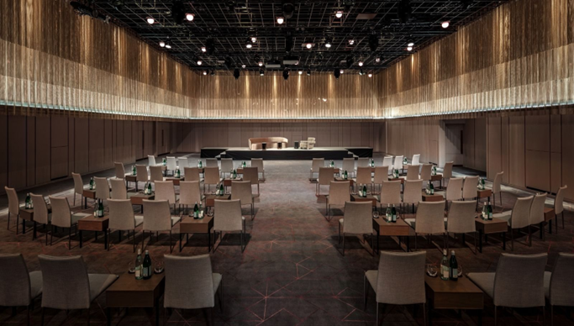
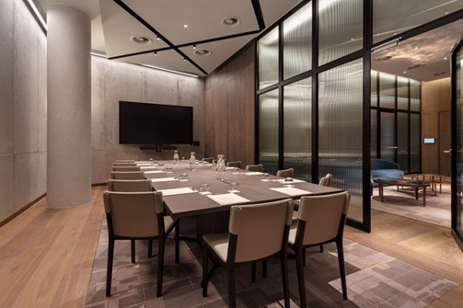
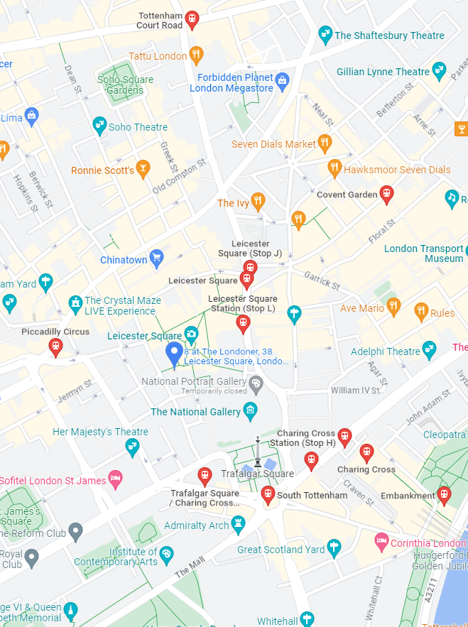
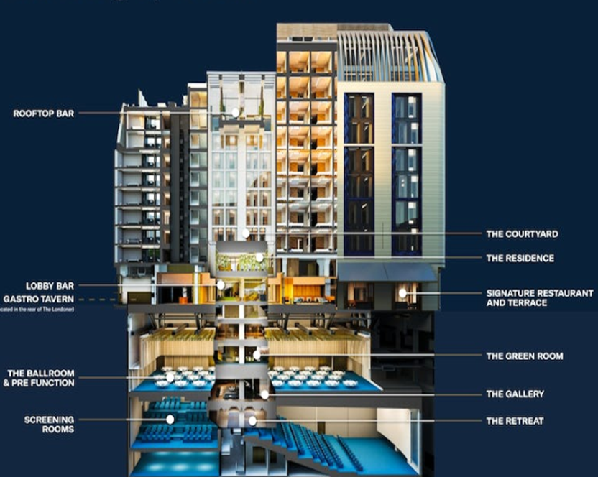
Venue: The Londoner
Overview
New venue in West End of London
Enough space to create internal lunch / working floors to mitigate being further from the office
Internal logistics - Ballroom/breakout rooms all located near each other with stair’s access so no issue with lifts
Lifts access from ballroom/breakout rooms straight up to bedroom floors
Separate event entrance to main hotel entrance with quick access to event space
Event all in one space – conference, dinner, bedrooms

Slide 6
Key milestones
September
Date & venue confirmed and communicated
October
Confirm invite creative
November
Agenda finalised inc breakouts
December
January
Save the date shared internally and externally
Confirm event theme
Draft agenda shared internally
Invite sent out to clients
Creative look and feel inc branding finalised
Joining instructions shared with clients
Presentations finalised
Content sessions
Tuesday
30 Jan
UK AIF
Wednesday 31 Jan
Global AIF

