Slide 1
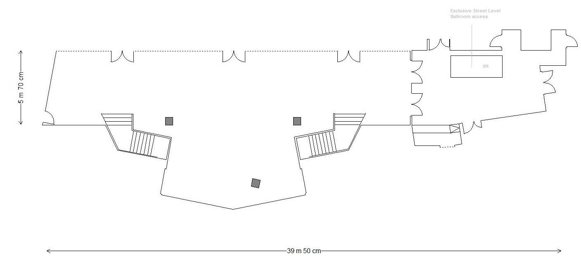
Ballroom Foyer
Entrance to Ballroom (conference room)
Holo box
1
2
3
4
Private Conference entrance
6
9
5
8
6
7
Stairs to Bankside Balcony
Stairs to Bankside Balcony
1 = Gold Sponsor
2 = Gold Sponsor
3 = Gold Sponsor
4 = Gold Sponsor
5 = Gold Sponsor
6 = Gold Sponsor
7 = Gold Sponsor HOSPA
8 = Gold Sponsor – Room To Reward
9 = Gold Sponsor
10 = Gold Sponosr
Mirrored pillar
Catering Area

Slide 2
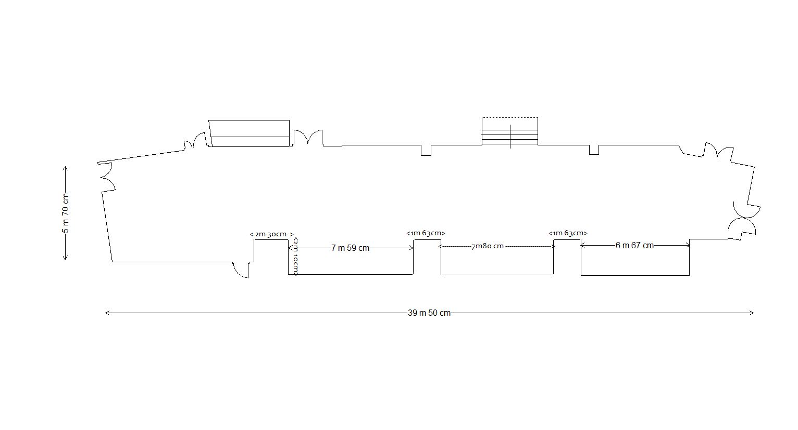
Exhibitor Area Floor Plan – Bankside Balcony
Stairs to conference room entrance
Private Conference entrance
Cloakroom
11
12
13
14
Registration
Catering point
Catering point
16
17
18
19
20
15
Bar
Bar (teas, coffees to be served here)

